Slide 1

ADVENTURE WORKS ANALYSIS

Slide 2


Introduction to Adventure Works Cycles
Who We Are
Adventure Works Cycles is a leading manufacturer of high-quality bicycles, components, and accessories.
Mission Statement
The mission is to deliver innovative, reliable, and high-performance cycling products.
Contact Information https://www.adventure-works.com/

Slide 3




18K
29M
Our Loyal Customers
Total Revenue
Key Insights
28K
33.15%
Total Orders
Profit %

Slide 4
“Slight Majority”: Men account for 50.6% of purchases, reflecting a strong market presence in this demographic.
49.4%
50.6%
CUSTOMERS

Slide 5
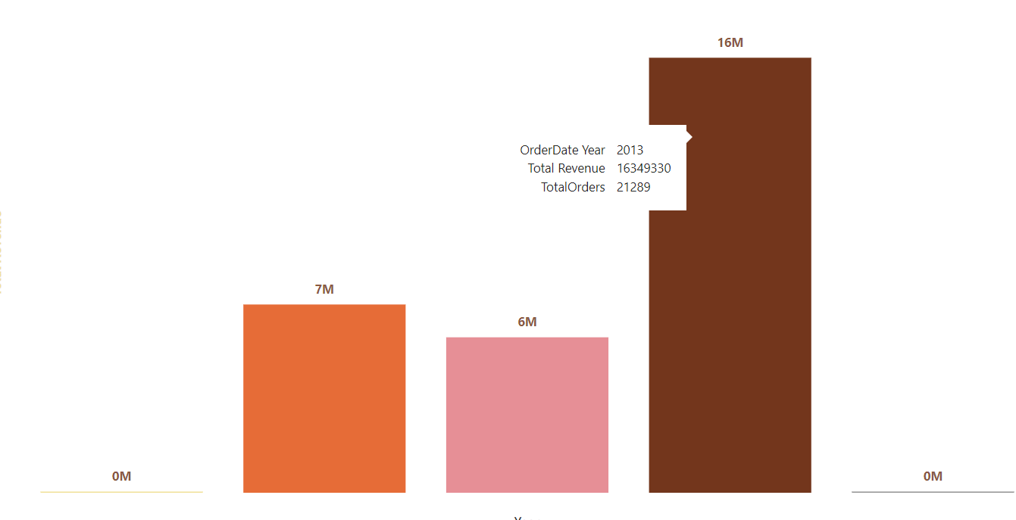
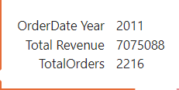
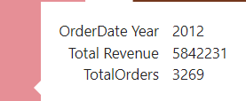
Here, we can see Year wise Revenue & Orders
2010
2011
2012
2013
2014
“Peak Revenue Performance”: 2013 marks the highest revenue year, indicating strong market demand and successful sales strategies.

Slide 6
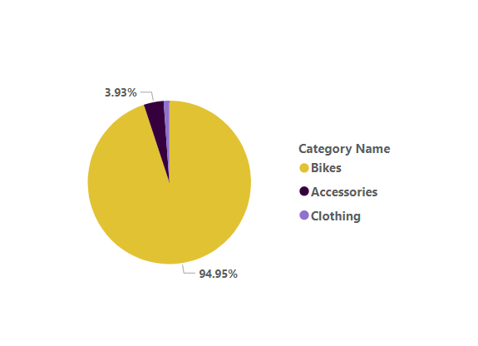
Here, we can see Profit by Category
“High Market Demand” Bikes represent 94.95% of the sales, indicating strong consumer preference and market demand.

Slide 7
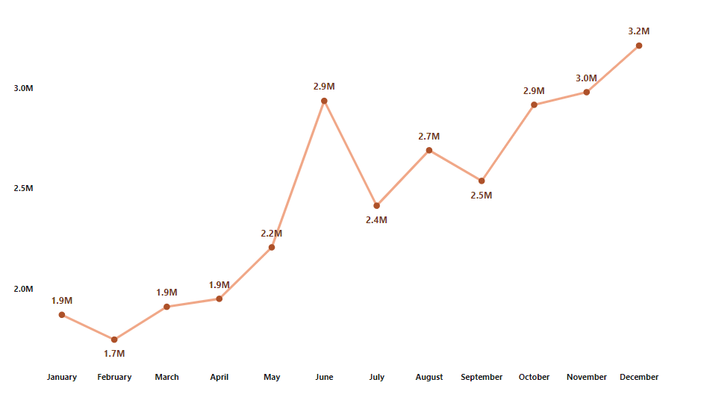
Here, we can see Sales by Month
“Seasonal Demand Surge”: November and December typically see increased consumer spending due to holiday shopping.

Slide 8
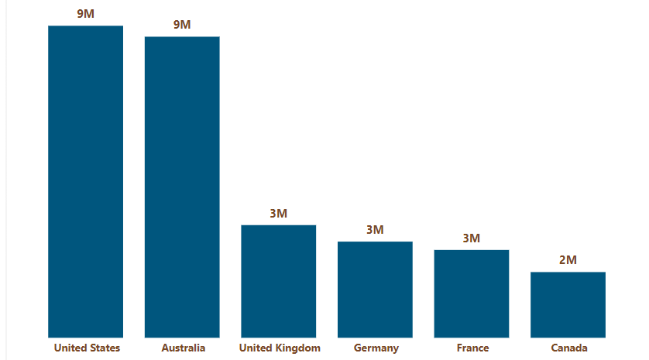

Here, we can see Country wise Sales
“Strong Purchasing Power”: High disposable incomes in the ‘US’ and ‘Australia lead to increased spending on bikes.

Slide 9

Product Innovation & Future Strategy
1
2
3
Innovation
Sustainability Efforts
Expansion Plans
Adventure Works Cycles is committed to investing in research and development to create cutting-edge cycling products, including e-bikes and high-performance components.
We are committed to sustainable practices by using eco-friendly materials and reducing carbon footprint throughout the manufacturing process.
Adventure Works Cycles plans to expand its product range to include new categories and explore opportunities in emerging markets.

Slide 10




Conclusion and Next Steps
1
Focus on Top Performers
Prioritize product categories and regions with the highest sales and growth potential.
2
Expand Market Presence
Increase online visibility and reach new customers through e-commerce platforms and targeted marketing campaigns.
3
Optimize Operations
Continuously monitor production costs, sales efficiency, and market trends to maximize profitability.

Slide 11


Thank You!

